Slide 1
ContactManager
14 September 2011
Notes:
ContactManager - <number>
Guidewire training materials contain Guidewire proprietary information that is subject to confidentiality and non-disclosure agreements. You agree to use the information in this manual solely for the purpose of training to implement Guidewire software solutions. You also agree not to disclose the information in this manual to third parties or copy this manual without prior written consent from Guidewire. Guidewire training may be given only by Guidewire employees or certified Guidewire partners under the appropriate agreement with Guidewire.

Slide 2
Lesson objectives
By the end of this lesson, you should be able to:
  Describe the basic functionality and data model for contacts
  Integrate ClaimCenter and ContactManager
  Extend the contact data model
  Configure how contacts are linked
  Describe the functionality of the auto sync feature
  This lesson uses the notes section for additional explanation and information.
  To view the notes in PowerPoint, choose View→Normal or View→Notes Page.
  If you choose to print the notes for the lesson, be sure to select “Print hidden slides.”
Notes:
ContactManager - <number>

Slide 3
Lesson outline
Contact basics
ClaimCenter and ContactManager integration
Extending the Contact entity
Linking configuration
Syncing configuration
Notes:
ContactManager - <number>

Slide 4

Contacts
Contact
Claimant
Reporter
Auto Repair
Shop
Hospital
Court
A contact is a person, company, or place which is related to the claim, such as...
  Someone who suffered a loss
  Some company which repaired a damaged asset
  Some venue where disputes were resolved
Notes:
ContactManager - <number>
A venue is a location for a scheduled event relevant to claims processing. Typically, venues are places where dispute resolution occurs, such as a courthouse or a conference room used for arbitration.

Slide 5
The contact subtype hierarchy
Contact
the primary subtypes
Person
Company
Venue
Person Vendor
Adjudi-
cator
Company Vendor
Legal
Venue
searches at this level return doctors and attorneys
Law Firm
Attorney
Medical Care Org
searches at this level return only doctors
Doctor
Auto Towing
Auto Repair
Notes:
Contacts - <number>
Contacts within ClaimCenter are organized into a set of subtypes that is fully customizable. The organization of the hierarchy helps to specify and enable certain types of functionality. For example:
The hierarchy helps to define the sorts of searches users can do. You can easily configure search screens for any node in the hierarchy. The search results will include matching contacts at or below that node. In the example above, a user could do a search for attorneys (which will return just attorneys), or for doctors (which will return just doctors), or for person vendors (which will return both attorneys and doctors, but not law firms or medical care organizations because they are not underneath the "Person Vendor" node of the hierarchy).
The hierarchy helps to define the criteria for identifying two objects as possible matches. For example, if the matching logic for law firms, medical care organizations, auto towing and auto repair shops is identical (the tax ID for the two objects must match), then this logic can be specified at the Company Vendor level.
There are three primary subtypes in the contact subtype hierarchy: person, company, and venue. This level of the hierarchy cannot be modified. All modifications to the hierarchy must be made below this level, and each subtype must be a child (directly or indirectly) of one of these three subtypes.
An adjudicator is not a claims adjuster. An adjudicator is a judge or arbitrator as a type of Person. An adjudicator may have a specific adjudicative domain. A carrier could easily configure ClaimCenter to have adjudicator treated as a child of the "person vendor" node if they desired.

Slide 6
Contact tags
Provide a means of further classifying contacts as:
  Vendors
  Claim party
  Client
Every contact can have as many contacts as necessary
Managed by applications
Visible in ContactManager
Not visible in other applications
Notes:
Guidewire Contacts and ContactManager - <number>
Contact tags are new in ContactManager 7.0. Multiple tags can be applied to a contact. For example, a doctor might provide medical services to an individual as a vendor in one claim, but if that doctor were to be in a car accident and file a claim they would also be tagged as a claim party.
Tags are applied to a contact by the applications as they affect the manage the contact record. When a contact is added to a claim in ClaimCenter, ClaimCenter applies the Claim Party tag, and if the contact is of a vendor subtype it also applies the Vendor tag. When contacts are created in PolicyCenter it applies the Client tag. Tags are not displayed in the user interfaces of ClaimCenter, PolicyCenter, or BillingCenter, as the user does not have to do anything to set the tag values—the applications manage setting the tags. Tags are visible in ContactManager and are rendered as a multi-select list. A Guidewire customer might have one or more persons designated to use ContactManager to add and modify contacts (particularly Vendor contacts), and they can use the multi-select list to enable and disable the various tags. Although the tags are not visible in the interfaces of the applications, this can be done if the customer wishes by modifying the page configuration files.
In order to create a contact in ContactManager, it must have at least one tag. Being able to select multiple tags in the Contact Manager interface enables that contact to function in different roles.
Searching for contacts in PolicyCenter only returns contacts that have the Client tag applied.
New tags can also be added to the system.

Slide 7


ClaimCenter and ContactManager both store contacts
Contact
Manager
contacts relevant to
a
claim
contacts relevant to multiple claims
Two applications store contacts
  ClaimCenter stores contact information as it pertains to a given claim
  ContactManager stores contacts that are relevant to multiple claims (typically vendor contacts)
Notes:
ContactManager - <number>
Most carriers with claims processing systems have a contact management application, which is often referred to in the industry as the "address book".
ClaimCenter comes with a separate contact management application named ContactManager. ClaimCenter and ContactManager are integrated, and most of the functionality belonging to ContactManager appears seamlessly in ClaimCenter. The ContactManager application functionality is typically referenced within ClaimCenter using the term "Address Book".
This lesson discusses the functionality specific to managing contact information and Guidewire's ContactManager application.

Slide 8
"Single use" contacts
Contact
Manager
Claim
000-00-002006
Doris Schwartz
(witness)
Typically a non-vendor, non-venue contact, such as the insured, a claimant, or a witness
Notes:
Contacts - <number>
A ClaimCenter contact may exist only in ClaimCenter (and not in ContactManager). This is typical when the contact is not expected to be used for any other claim (such as a witness or a third-party claimant), which is typically true for a contact that is not a vendor or a venue. There is no need for contact information to be shared across multiple claims, so the contact is not stored in ContactManager.

Slide 9
"Multi-use" contacts
Contact
Manager
Claim
000-00-002006
Dr. Matt Sawyer (1)
Claim
036-22-934712
Dr. Matt Sawyer (AB)
Dr. Matt Sawyer (2)
Claim
908-00-230166
Typically a vendor (or venue)
Dr. Matt Sawyer (3)
Notes:
Contacts - <number>
A ClaimCenter contact may also exist in ContactManager. This is typical when the contact is used or is expected to be used for multiple claims. This is typically true for person vendors such as doctors, company vendors such as hospitals, or venues such as courts. Theoretically, it could also include a policy holder with a large number of potential claims, such as a large business with a workers' comp policy. Because there is a need for contact information to be shared across multiple claims, the contact is stored in the address book. In the diagram above, the "AB" after the ContactManager Matt Sawyer stands for "address book".

Slide 10
Multi-use contacts are typically "linked"
Contact
Manager
in
sync
Dr. Matt Sawyer (1)
phone: 324-6600
out of sync
Dr. Matt Sawyer (AB)
phone: 324-6600
Dr. Matt Sawyer (2)
phone: 453-2331
in
sync
Dr. Matt Sawyer (3)
phone: 324-6600
Notes:
Contacts - <number>
When a contact exists in both ClaimCenter and ContactManager, every copy of the contact is a unique (but potentially related) object. Notice that there are four Matt Sawyer objects. The ContactManager version is suffixed with "AB". All the other version are suffixed with a distinct integer. Even though they all represent the same person, they are four distinct objects.
When a contact exists in both ClaimCenter and ContactManager, it can be linked (and most likely is). When a contact is linked:
The ClaimCenter user interface identifies that the contact is linked.
The ClaimCenter user interface identifies when a contact's information is not identical to the corresponding ContactManager object. This is referred to as being "out of sync". (Although it is likely that the majority of the fields will store the same data, it is possible for individual fields to differ from one related contact to the next. For example, the phone number for Matt Sawyer (2) is different than the phone number for all the other Matt Sawyer objects.)
A user can recopy the information from the ContactManager object to the ClaimCenter object. This is referred to as "syncing the contact".
A user can search for contacts in ContactManager that meet some criteria pertaining to ClaimCenter data. For example, you can search within ContactManager for all claims related to Matt Sawyer. The contact used for the search criteria exists in ContactManager, but the claims returned from the search come from ClaimCenter.
(continued)

Slide 11

(Notes only slide)
Notes:
Contacts - <number>
Even if two objects are linked, modifications to one of the objects are not inherently replicated to the other linked objects. For example, a change made to the object in ClaimCenter is not inherently copied to ContactManager, and a change made to the object in ContactManager is not inherently copied to all instances of the claim in ClaimCenter. However, contact data can be synchronized both automatically as well as by the user; this copies the information from ContactManager to the ClaimCenter object

Slide 12

Contact data model
Contact
Manager
Claim
First: Matt
Last: Sawyer
Phone: 324-6600
First: Matt
Last: Sawyer
Phone: 324-6600
Contacts
ClaimContact
Contact
ABContact
Roles
integration
point
ClaimContact
Role
Role: Doctor
Notes:
ContactManager - <number>
The Claim entity stores claims.
The ClaimContact entity stores linking information about one contact for a claim. Because a claim can have multiple contacts, the relationship between Claim and ClaimContact is one-to-many—the Claim entity has an array of ClaimContacts, but the array itself is named "Contacts".
The information about the contact itself is stored in the Contact entity. Each ClaimContact object record relates to exactly one Contact record. When a claim is linked, the Contact entity shares information with some entity of the address book application. The Contact entity is separate from the ClaimContact entity because the Contact entity stores both contacts on a claim and ClaimCenter users. (For example, both Ray Newton, a claimant for a claim, and Andy Applegate, the adjudicator for the claim, are stored in the Contact entity.) Every instance of ClaimContact links to a Contact object, but there are some Contact objects (the user objects) that are not mapped to by any ClaimContact objects.
Every contact has one to many roles on the claim. Therefore, there is a one-to-many relationship to the ClaimContactRole entity. This relationship starts from the ClaimContact entity (as opposed to the Contact entity) because only contacts on a claim can have a role.
ABContact is the name of the main contact entity in ContactManager.

Slide 13
Common ContactManager configurations
Integrating ClaimCenter and ContactManager
Making parallel changes to the two contact data models so that contacts can be in sync
Configure the way in which linking is executed
Configure auto sync to automatically keep contacts in sync
Notes:
ContactManager - <number>

Slide 14
Lesson outline
Contact basics
ClaimCenter and ContactManager integration
Extending the Contact entity
Linking configuration
Syncing configuration
Notes:
ContactManager - <number>

Slide 15
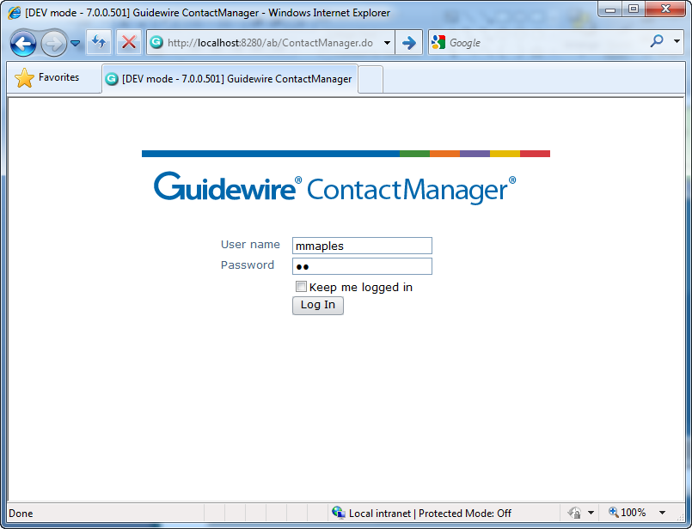

Accessing ContactManager
Notes:
Contacts - <number>
The process of logging on to ContactManager is identical to that of ClaimCenter. To log in to an application, end users must open an instance of Internet Explorer and access the system through the appropriate Universal Resource Locator (URL, also more commonly known as a "web address"). The URL is:
http://machine:port#/instanceName/ContactManager.do, where:
machine is the name of the host machine, and
port# is the port which Internet Explorer should use to access the application, and
instanceName is the name of the instance of ContactManager (typically "ab", for address book).
Other than the URL itself, the process of logging on to ClaimCenter and ContactManager is identical.
Typically, the only types of business users who have access directly to the ContactManager application are vendor managers.
ContactManager should run on a dedicated application server, rather than running on the same application server that runs other Guidewire applications.

Slide 16
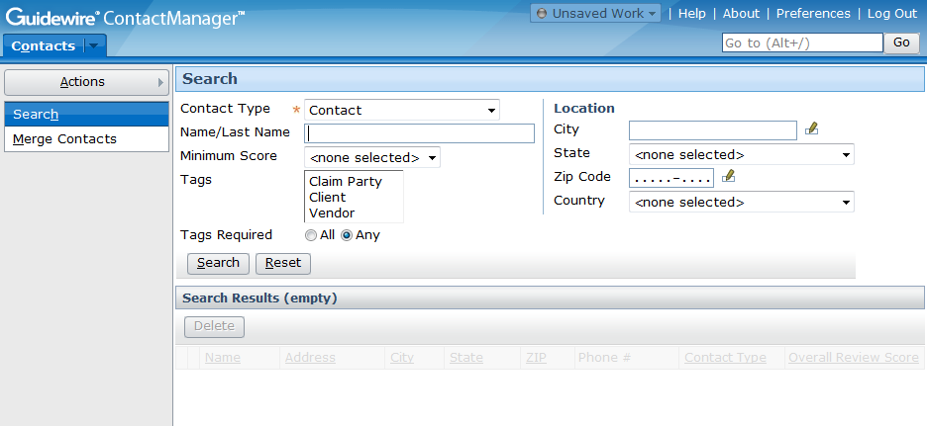
The ContactManager interface
Notes:
Contacts - <number>
The ContactManager interface is relatively simple compared to ClaimCenter. It has the five areas (tab bar, info bar, side bar, screen area, and workspace frame) with the same screens and navigation conventions, but:
The base application has only two tabs.
The base application makes no use of the workspace frame.
The base application has fewer aspects of major functionality.

Slide 17
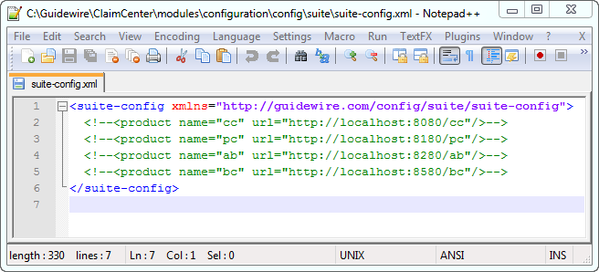
Configuring suite-config.xml in ClaimCenter
In Studio, expand Other Resources
Click suite-config.xml to open it in editor
Remove comments around all applications to be integrated
Notes:
TrainingApp Business Functionality - <number>

Slide 18
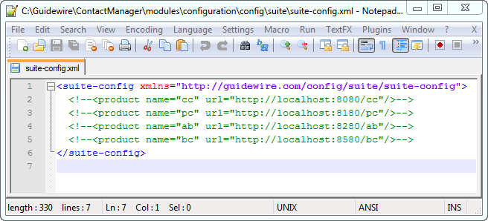
Configuring suite-config.xml in ContactManager
Repeat process in ContactManager
Notes:
TrainingApp Business Functionality - <number>

Slide 19

ClaimCenter integration plugin
Contact
Manager
Contact
Manager
IAddressBookAdapter
IAddressBookAdapter is a ClaimCenter plugin that integrates ClaimCenter with an address book application
  Initially, plugin reflects CC contacts back to CC
  During integration, plugin class changed to retrieve contacts from address book
Notes:
ContactManager - <number>
The IAddressBookAdapter plugin can be used to integrate with any address book, not just ContactManager. Guidewire provides an out-of-the-box implementation that integrates with ContactManager

Slide 20
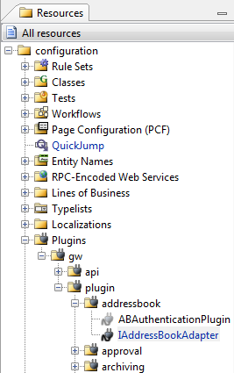
ClaimCenter plugin resources
Plugins are defined in Studio under the Plugins node
  Whenever you make a change to a plugin, you must stop and restart ClaimCenter for the change to take effect
Notes:
ContactManager - <number>

Slide 21
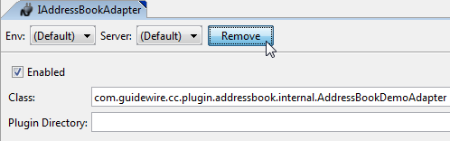
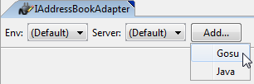
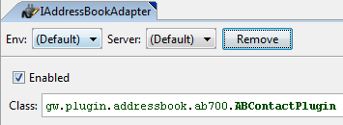
Configuring the IAddressBookAdapter
Notes:
ContactManager - <number>
To configure the IAddressBookAdapter to connect ClaimCenter with ContactManager:
Navigate to the IAddressBookAdapter.
Click the Remove button. This deletes the base application's reference to the address book demo adapter class, which is the class used to get ClaimCenter to reflect its own contacts back to itself.
Click Add. In the dropdown that appears when you click the Add button, select Gosu.
Type "gw.plugin.addressbook.ab700.ABContactPlugin" in the Class field.
Save the plugin.

Slide 22
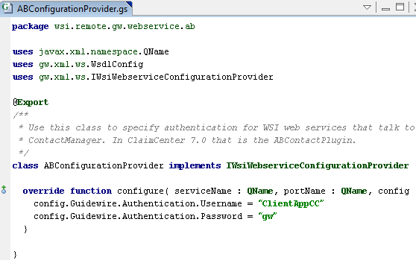
Configuring authentication in ClaimCenter
Navigate to Classes > wsi > remote > gw > webservice > ab > ABConfigurationProvider
Confirm username is set to ClientAppCC and password is set to gw
Notes:
The ClientAppCC user exists in the sample data, which is loaded in the training instances of the applications. In a production environment you would need to create user accounts in each application that have the required permissions, and configure the ABConfigurationProvider class to use the account. For more information on the required permissions, see the documentation.
Guidewire Contacts and ContactManager - <number>

Slide 23
ContactManager integration plugin
Contact
Manager
ClaimSystemPlugin
ClaimSystemPlugin is a ContactManager plugin that integrates ContactManager with ClaimCenter
Notes:
ContactManager - <number>
The ClientSystemPlugin enables ContactManager to send updates to ClaimCenter.

Slide 24
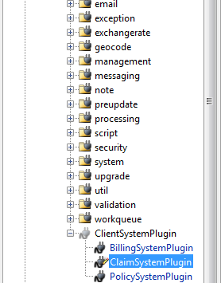
ContactManager plugin resources
Plugins are defined in Studio under the Plugins node
  Whenever you make a change to a plugin, you must stop and restart ContactManager for the change to take effect
Notes:
ContactManager - <number>

Slide 25
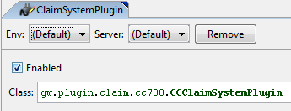
Configuring the ClaimSystemPlugin
Repeat process to set ClaimSystemPlugin in ContactManager Studio to gw.plugin.claim.cc700.CCClaimSystemPlugin
Notes:
ContactManager - <number>
To configure the ClaimSystemPlugin to connect ContactManager with ClaimCenter:
Type "gw.plugin.claim.cc700.CCClaimSystemPlugin" in the Class field.
Save the plugin.

Slide 26
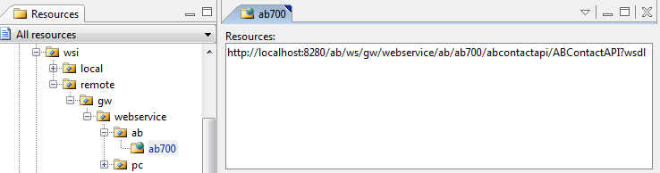
Update ContactManager WSDL in ClaimCenter
Start ContactManager server
In ClaimCenter Studio, navigate to Classes > wsi > remote > gw > webservice > ab > ab700
Make sure Resources pane includes ${ab}/ws/gw/webservice/ab/ab700/abcontactapi/ABContactAPI?wsdl
Click Fetch Updates
Notes:
The Fetch Updates button retrieves the most current version of the web-service definition language (WSDL) file.
Any changes to the data model require that the WSDLs be updated.
Guidewire Contacts and ContactManager - <number>

Slide 27
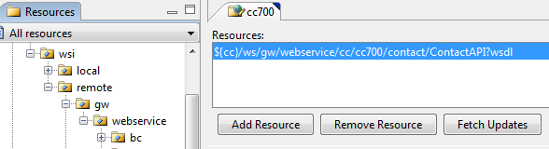
Update ClaimCenter WSDL in ContactManager
Start ClaimCenter server
In ContactManager Studio, navigate to Classes > wsi > remote > gw > webservice > cc > cc700
Make sure Resources pane includes ${cc}/ws/gw/webservice/cc/cc700/ContactAPI?wsdl
Click Fetch Updates
Notes:
The Fetch Updates button retrieves the most current version of the web-service definition language (WSDL) file.
Any changes to the data model require that the WSDLs be updated.
Guidewire Contacts and ContactManager - <number>

Slide 28
Restart servers
Stop ClaimCenter server
Stop ContactManager server
Start ContactManager server
Start ClaimCenter server
Notes:
Guidewire Contacts and ContactManager - <number>

Slide 29
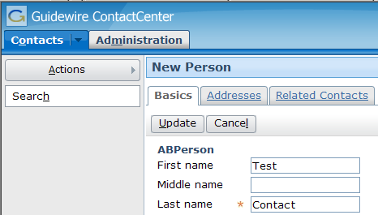
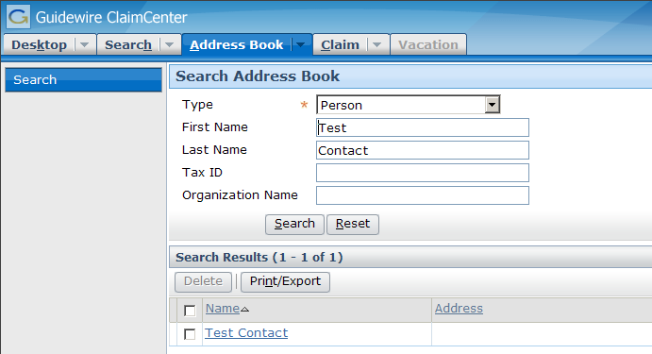
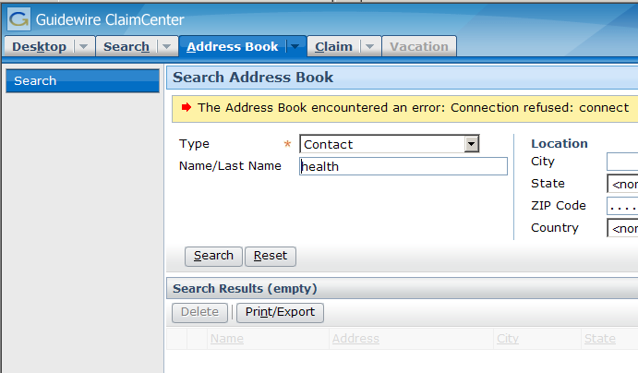
Testing the integration
Contact
Manager
Notes:
ContactManager - <number>
Recall that ContactManager data is visible from ClaimCenter's Address Book tab. To test the integration:
Create a contact in ContactManager (such as "Test Contact" shown above).
In ClaimCenter, go to the Address Book tab and search for that contact. If the contact appears in the search (as is shown on the lower left screenshot), then the integration was successful.

Slide 30
Lesson outline
Contact basics
ClaimCenter and ContactManager integration
Extending the Contact entity
Linking configuration
Syncing configuration
Notes:
ContactManager - <number>

Slide 31
Entities that store contacts
Contact
Manager
Claim
ClaimContact
Contact
ABContact
Person
Place
ABPerson
ABPlace
Company
integration
point
ABCompany
ClaimContact
Role
To enable linking of contacts, two contact data models must have similar structure
Notes:
ContactManager - <number>
In an integrated instance of ClaimCenter and ContactManager, there are two entities that store contact information: ClaimCenter's "Contact" entity and ContactManager's "ABContact" entity. The contact subtypes must be mapped if the hierarchies are different between ClaimCenter and ContactManager. The mapping files are addressed in subsequent slides. Each application can manage different fields; for example, there might be data stored in ClaimCenter that is only relevant to ClaimCenter and does not need to be managed centrally in ContactManager. If there are fields that you do not need integrated, you can just leave them out of the mapping file

Slide 32

Mapping between ContactManager and applications
messaging
Notes:
If you extend the data models in ClaimCenter and ContactManager you must also change the logic that assembles the properties and child entities of the contact data to and from the XML structure so that the information is included in the data that is exchanged over messaging.
TrainingApp Business Functionality - <number>

Slide 33
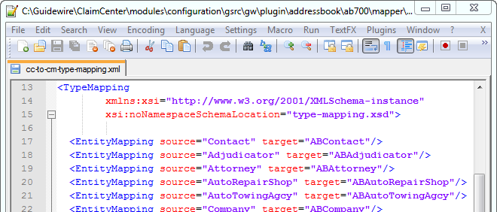
Map entities and typecodes in ClaimCenter
Add or modify EntityMapping elements in cm-to-cc-type-mapping.xml to map ClaimCenter entity names and typecodes into the values required by the XSD for sending data to ContactManager.
Notes:
The cm-to-cc-type-mapping.xml file is located in Other Resources. In the screenshot, the type mapping file maps the ABAdjudicator subtype to the Ajudicator subtype, the ABAttorney subtype to the Attorney subtype, and so forth.
Configuring ContactManager - <number>

Slide 34
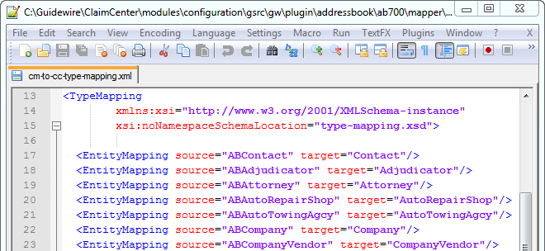
Map entities and typecodes in ClaimCenter (cont)
Add or modify EntityMapping elements in cm-to-cc-type-mapping.xml to map ContactManager entity names and typecodes from the XSD into the values required by ClaimCenter when it receives data from ContactManager
Notes:
The cm-to-cc-type-mapping.xml file is located in Other Resources. In the screenshot, the type mapping file maps the ABAdjudicator subtype to the Ajudicator subtype, the ABAttorney subtype to the Attorney subtype, and so forth.
Configuring ContactManager - <number>

Slide 35
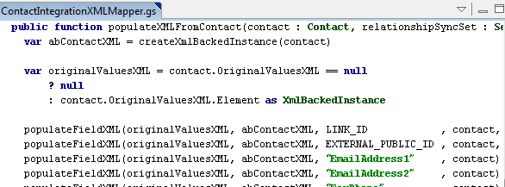
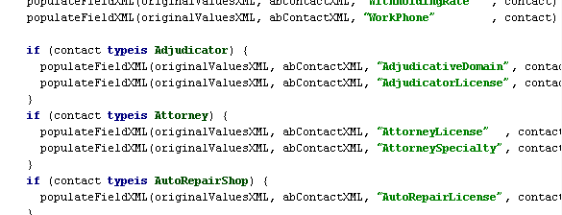
Map properties in ClaimCenter
Add "populateXML" methods to populateXMLFromContact to produce XML from contact object to send to ContactManager
Notes:
The ContactIntegrationXMLMapper.gs class is located in Classes > gw > plugin > addressbook > ab700 > mapper.
Configuring ContactManager - <number>

Slide 36
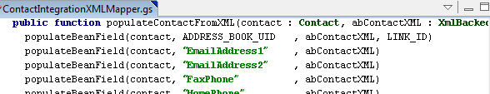
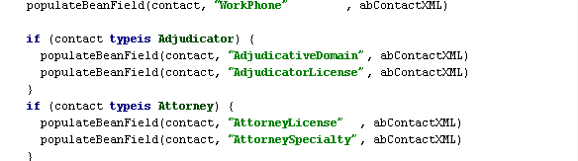
Map properties in ClaimCenter (cont)
Add "populateBean" methods within populateContactFromXML to produce a contact object from XML received from ContactManager
Notes:
Configuring ContactManager - <number>

Slide 37
Mapping between ABContact and applications
ContactManager
messaging
Notes:
Just as contact data is assembled into an XML structure that is exchanged over messaging queues for ClaimCenter, the same is true of ContactManager. If you extend the contact data model you typically have to make similar extensions in ContactManager. And if you change the data model, you must also change the logic that assembles the properties and child entities of the contact data to and from the XML structure so that the information is included in the data that is exchanged over messaging.
TrainingApp Business Functionality - <number>

Slide 38
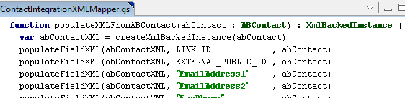
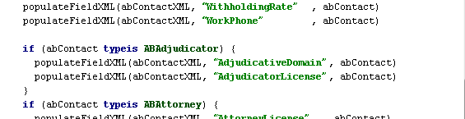
Map properties in ContactManager
Add "populateXML" methods to populateXMLFromABContact to produce XML from contact object to send to applications
Notes:
The ContactIntegrationXMLMapper.gs class is the Gosu class that performs the mapping between the ABContact data that is stored in the database and the XML content that is exchanged over messaging with the other applications. It is located in Classes > gw > webservice > ab > ab700 > abcontactapi.
There are different methods for populating individual fields, foreign keys, and arrays. For more information, refer to the ContactManager documentation.
Configuring ContactManager - <number>

Slide 39
Lesson outline
Contact basics
ClaimCenter and ContactManager integration
Extending the Contact entity
Linking configuration
Syncing configuration
Notes:
ContactManager - <number>

Slide 40
Three possible link statuses
Address
Book
Dr. Matt Sawyer (1)
phone: 324-6600
unlinked
linked
(in sync)
Dr. Matt Sawyer (2)
phone: 324-6600
Dr. Matt Sawyer (AB)
phone: 324-6600
linked
(out of sync)
Dr. Matt Sawyer (3)
phone: 453-2331
Notes:
ContactManager - <number>
Typically, "single-use" contacts (contacts that are relevant to only one claim) are not linked, and the discussion of linking is irrelevant. The remainder of this section focuses exclusively on contacts that are or could be multi-use contacts.
For "multi-use" contacts (contacts that are relevant to multiple claims), there are three possible states the contact can be in:
Unlinked
Linked and in sync (all data in the claim contact matches the data in the ABContact)
Linked and out of sync (some data in the claim contact does not match the data in ABContact)
When a linked contact is updated in ClaimCenter, you have the following options:
Update both ClaimCenter and ContactManager
Update just the ClaimCenter copy of the contact but keep the link
Unlink and keep the ClaimCenter contact separate

Slide 41
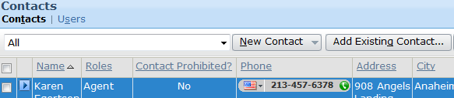
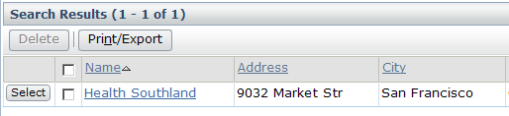
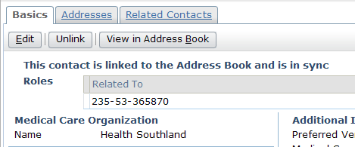
Contacts created from ContactManager are linked
When a contact copied from ContactManager by using the Add Existing Contact… button, the contact is initially linked
Notes:
ContactManager - <number>

Slide 42

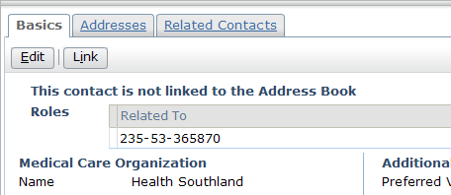
Linking an unlinked contact
Contact
Manager
findDuplicates
A user can attempt to link an unlinked contact; ClaimCenter calls the ContactManager findDuplicates web service to determine if a matching contact exists
Notes:
ContactManager - <number>

Slide 43
The linking process
Multiple exact matches or potential match in CM?
User has permissions to create contact in CM?
Exact match in CM?
no
no
no
yes
yes
yes
Contact
linked to exact
match
Matches listed; user chooses match to link
ABContact created and linked to CC Contact
Link fails; error message displayed
Notes:
ContactManager - <number>
When a user clicks the link button, there are four possible outcomes:
An exact match is found, the AddressBookUID property of the local contact is set to the LinkID unique identifier property of the ContactManager contact, and the CC object is linked to that match (though the records are not necessarily in sync).
One or more possible exact matches or potential are found, and the user is asked to identify one of them as the match. The CC object will be linked to that match, though the records will not necessarily be in sync.
No matches are found, but because the user has sufficient permissions to create contacts in ContactManager, a new contact is created and linked to the CC contact. The records are in sync.
No matches are found, and the user has insufficient permissions to create contacts in ContactManager. The process fails.

Slide 44
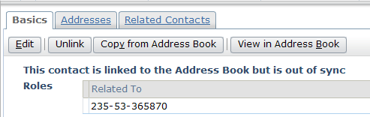
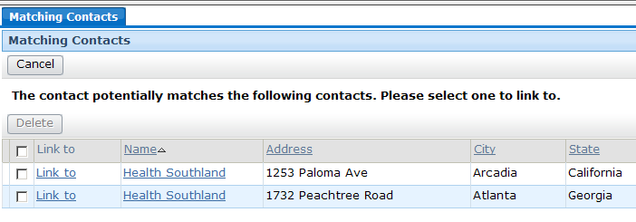
The linking process: Positive match results
Exact match in CM?
yes
Potential match in CM?
yes
Note that a matched contact is linked but not synced
Notes:
ContactManager - <number>

Slide 45
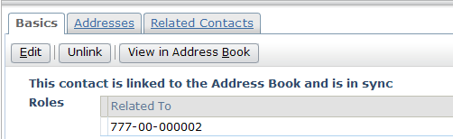
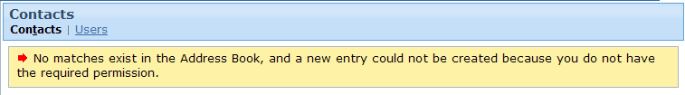
The linking process: No match results
User has permissions to create contact in CM?
yes
no
Note that if a new CM contact is created, it is in sync with the CC contact
Notes:
ContactManager - <number>

Slide 46

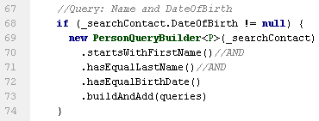
Exact and potential matching contacts
"Exact" matches evaluate information that is likely to uniquely identify a contact such as Tax IDs
"Potential" matches are based on less stringent criteria
Notes:
The isExactMatch method shown in the first screenshot is from the CompanyDuplicateFinder.gs class. If the name and tax ID of the contacts being compared are identical then the companies are considered to be exact matches.
The PersonQueryBuilder shown in the second screenshot is from the PersonDuplicateFinder.gs class. If the name and birth date of the contacts being compared are identical then the persons are considered likely to be matches. Although two persons should not have identical social security numbers (as those are intended to uniquely identify a person), two persons named John Smith might have been born on the same day.
The matching logic defined in these classes can be customized. The screenshots show the default logic from a new installation.
ContactManager - <number>

Slide 47
Lesson outline
Contact basics
ClaimCenter and ContactManager integration
Extending the Contact entity
Linking configuration
Syncing configuration
Notes:
ContactManager - <number>

Slide 48
Syncing ClaimCenter contacts
Contact
Manager
linked
(in sync)
Dr. Matt Sawyer (2)
phone: 324-6600
Dr. Matt Sawyer (AB)
phone: 324-6600
linked
(out of sync)
Dr. Matt Sawyer (3)
phone: 453-2331
Once linked, if data in either contact changes, records become out of sync
  Records can be synced manually or automatically
Notes:
ContactManager - <number>
When a logical contact exists in both applications, the ContactManager ABContact object is considered the "master" object. Whenever there are differences between a ClaimCenter-linked Contact object and the corresponding ContactManager ABContact object, the ClaimCenter Contact is considered to be "out of sync"—the contact is out of sync because the data in the local contact is different from the data that is in ContactManager. (Because the ContactManager ABContact object is the "master", it is never considered to be out of sync.)
The process of syncing a contact is the process of copying all ABContact data from ContactManager into a ClaimCenter Contact object.

Slide 49
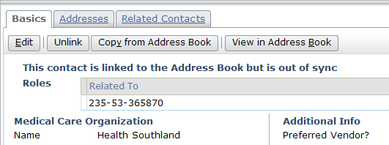
Manual synchronization
linked
(out of sync)
"Copy from Address Book" re-sync records
  AB contact data copied to CC contact record
  Overwrites any out-of-sync data in CC contact
Notes:
ContactManager - <number>
Manual synchronization is performed by the user on a single contact, whereas automatic synchronization is performed by the system on multiple contacts.

Slide 50
Automatic synchronization
linked
(out of sync)
Automatic synchronization is a feature that causes changes in ABContact records to be automatically synced with linked CC Contact records by the system
  Can be on or off for each ABContact
  Can be on or off for each CC Contact
  Performed by batch job
  Can be scheduled or instantaneous
Notes:
ContactManager - <number>

Slide 51
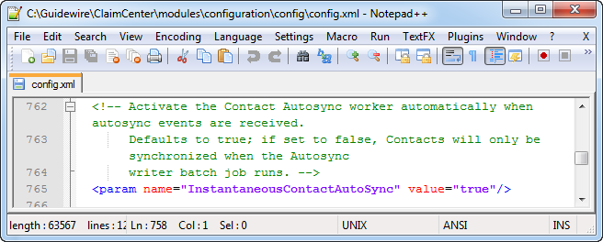
Enabling instantaneous synchronization
In Guidewire Studio expand Other Resources
Click config.xml to edit it
Set InstantaneousContactAutoSync to true or false
Notes:
ContactManager - <number>
Although synchronization can be configured to be immediate so that the automated batch process executes when the contact is updated, most implementations will not choose to do this because of the high demand it imposes on system resources. Entities can be selectively configured for instantaneous processing, though, so the majority might be configured for scheduled synchronization while others might be configured for instantaneous synchronization. To control the schedule of the batch process, adjust the schedule on <ProcessSchedule process="contactautosync">.
The InstantaneousContactAutoSync parameter is set to true by default; in ContactManager 7.0.1 the default value will be false.

Slide 52
Broadcasting changes
Contact
Manager
ABClientAPI
AutoSync: allow
AutoSync: allow
AutoSync: disallow
Notes:
ContactManager - <number>
ClaimCenter implements the ContactManager interface ABClientAPI, which provides the functionality for ContactManager to broadcast changes to contact data to ClaimCenter.
Every CC Contact object has an auto sync field whose status determines what happens if the contact is linked and the AB contact is updated.
Allow – When ABContact is updated, automatically sync this object
Disallow – Do not automatically sync this object
Suspended – Do not automatically sync this object (This is intended to indicate a temporary suspension of auto syncing. Typically, it is used when the object has been auto-sync'd in the past and may be again in the future.)
In the base application, this field is not exposed on the user interface.
You can control which types of contacts should be autosync’ed. To do this, modify one of the Contact Preupdate rules: COP01000, COP2500, and COP3000. For more information on these, see the Contact Management Guide.

Slide 53
Using auto sync to cascade changes
ClaimCenter
ContactManager
ID | Allow Auto-Sync | ABUID | Status
021 | true | 001 | in sync
022 | false | 001 | in sync
023 | true | 001 | in sync
ID | Initiate Auto-Sync
001 | true
ID | Allow Auto-Sync | ABUID | Status
021 | true | 001 | out of sync
022 | false | 001 | out of sync
023 | true | 001 | in sync
ID | Initiate Auto-Sync
001 | true
update via AB tab
ID | Allow Auto-Sync | ABUID | Status
021 | true | 001 | in sync
022 | false | 001 | out of sync
023 | true | 001 | in sync
ID | Initiate Auto-Sync
001 | true
broadcast update to CC
Notes:
ContactManager - <number>
(Top Diagram) ClaimCenter has three contacts (021, 022, 023) that are linked to CC contact 001. 021 and 023 have allow autosync set to true.
(Middle Diagram) A user updates ClaimCenter contact 023 and saves the information to ContactManager (using the save to Claim and ContactManager button – if they have permissions). This updates record 001.
(Bottom Diagram) Because record 001 has initiate auto-sync set to true, an event message is broadcast to ClaimCenter indicating the record has been updated. When ClaimCenter receives the message, ClaimCenter finds all CC contacts with an ABUID of 001. If their allow auto-sync field is set to true, then it syncs these records with the newly updated ContactManager record. At this point, record 023 is in sync (because it was where the update originated from) and record 021 is in sync (because record 001 was set to broadcast changes and record 021 was set to auto sync), but record 022 is out of sync (the corresponding record has changed and the CC record was not set to allow auto sync).

Slide 54
Lesson objectives review
You should now be able to:
  Describe the basic functionality and data model for contacts
  Integrate ClaimCenter and ContactManager
  Extend the contact data model
  Configure how contacts are linked
  Describe the functionality of the auto sync feature
Notes:
ContactManager - <number>

Slide 55
Review questions
What is the purpose of the ClaimContact entity?
Immediately after installation, what is the functionality of the IAddressBook plugin?
If you add a field to the Contact entity, what are the two things you must do on the ContactManager side to reflect those changes if they are to be used there as well?
When a user attempts to link a record:
  Does ContactManager search for both exact matches and potential matches?
  What happens if no matches can be found?
If an ABContact record is updated, what three things must be true in order for the change to be automatically made to any linked CC contact records?
Notes:
ContactManager - <number>
Answers
1. The ClaimContact entity's purpose is to link together all the contacts for a claim and, for each contact, all the roles that contact has on the claim.
2. The IAddressBook plugin reflects ClaimCenter contacts back to itself. This is useful for demo purposes, but it does not represent true integration. No data from an address book application is being used.
3. (1) Modify the ABContact entity as well. (2) Modify the mapping gosu files.
4. (a) Not necessarily. ContactManager always searches for an exactmatch. It searches for a potential match only if an exact one cannot be found. (b) If no match can be found and the user has sufficient permissions to create a match in ContactManager, then a record is created in ContactManager and linked to the ClaimCenter contact. Otherwise, an error occurs.
5. (1) The synchronization batch process must be configured to run. (2) (3) The CC contact records must allow auto syncing. (AutoSync must be set to "allow".)

Slide 56
Notices
Copyright © 2001-2011 Guidewire Software, Inc. All Rights Reserved.
Guidewire, Guidewire Software, Guidewire ClaimCenter, Guidewire PolicyCenter, Guidewire BillingCenter, Guidewire Reinsurance Management, Guidewire ContactManager, Guidewire Vendor Data Management, Guidewire Client Data Management, Guidewire InsuranceSuite, Guidewire ContactManager, Guidewire Studio, Gosu, Deliver Insurance Your Way, and the Guidewire logo are trademarks or registered trademarks of Guidewire Software, Inc. in the United States and/or other countries.
This material is Guidewire proprietary and confidential. The contents of this material, including product architecture details and APIs, are considered confidential and are fully protected by customer licensing confidentiality agreements and signed Non-Disclosure Agreements (NDAs).
This file and the contents herein are the property of Guidewire Software, Inc. Use of this course material is restricted to students officially registered in this specific Guidewire-instructed course, or for other use expressly authorized by Guidewire. Replication or distribution of this course material in electronic, paper, or other format is prohibited without express permission from Guidewire.
    Guidewire products are protected by one or more of the following patents: U.S. Patent No. 7,885,831; U.S. Patent No. 7,788,296.
Notes:
Introduction to Guidewire Configuration - <number>

